Slide 1
并行和分布式计算 Parallel and Distributed Computing 第 8 讲 CUDA编程（一）
张 奇
复旦大学 计算机科学技术学院

Slide 2
目录
9.1 GPU简介
9.2 CUDA编程模型
9.3 内存层次结构

Slide 3
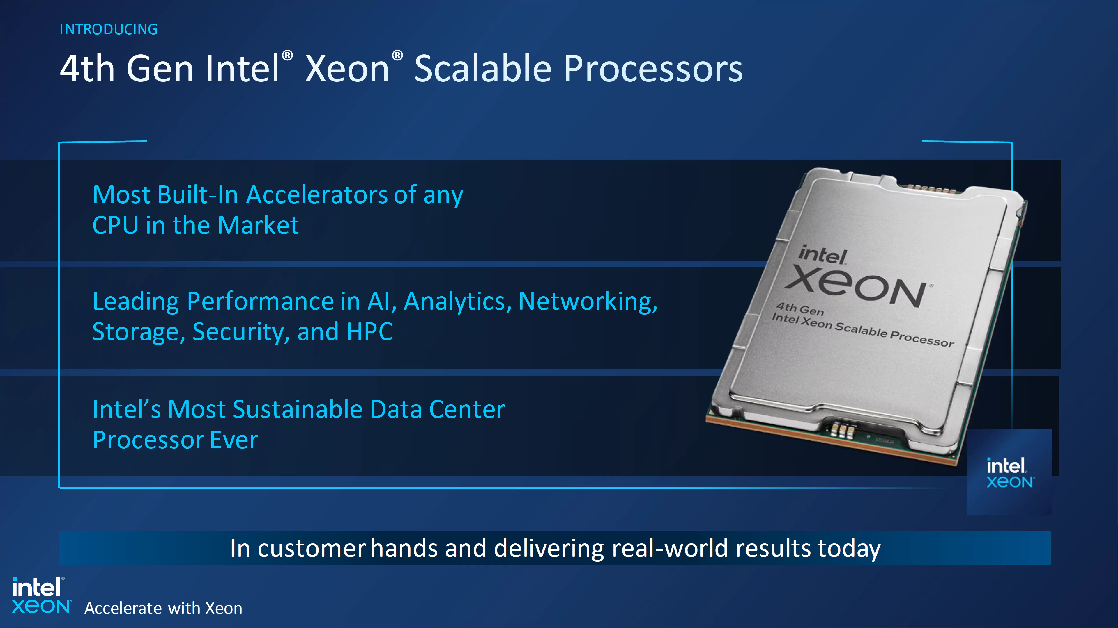
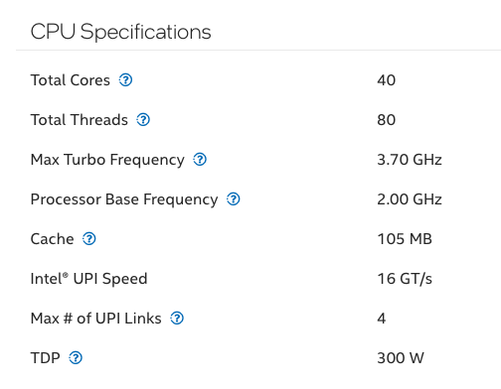
9.1 GPU简介
Intel® Xeon® Platinum 8460Y+ Processor
105M Cache, 2.00 GHz

Slide 4
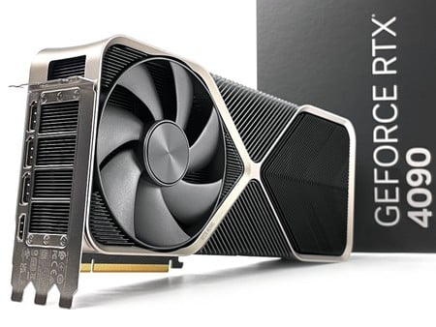
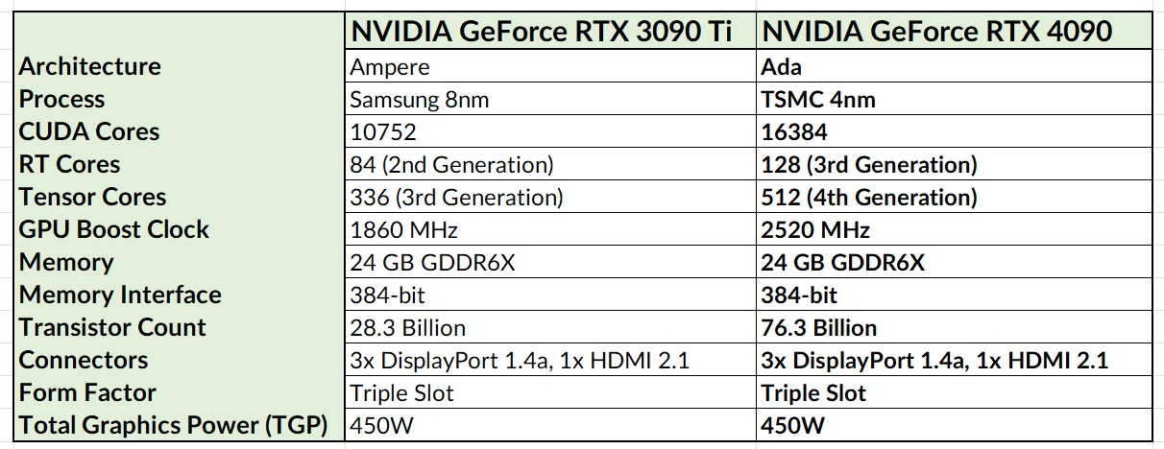
9.1 GPU简介

Slide 5
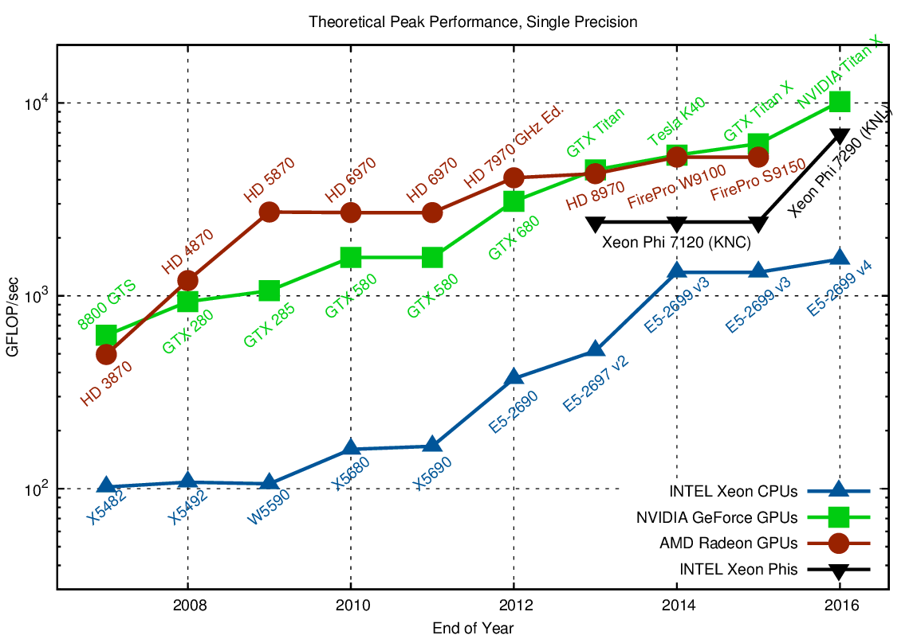
9.1 GPU简介
GPU is a hardware specially designed for highly parallel applications (graphics)

Slide 6
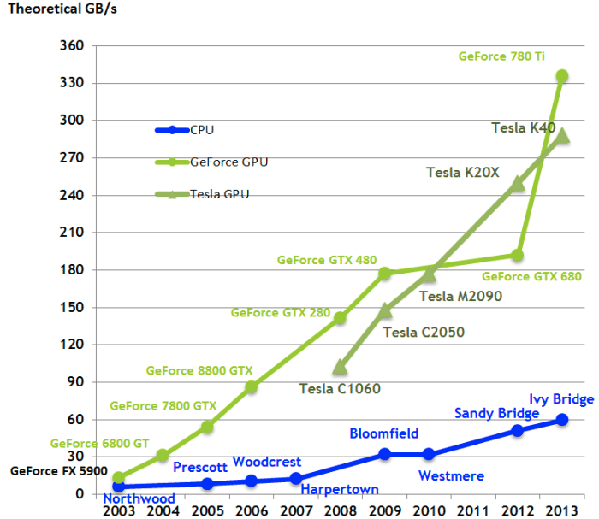
9.1 GPU简介
Fast processing must come with high bandwidth!

Slide 7
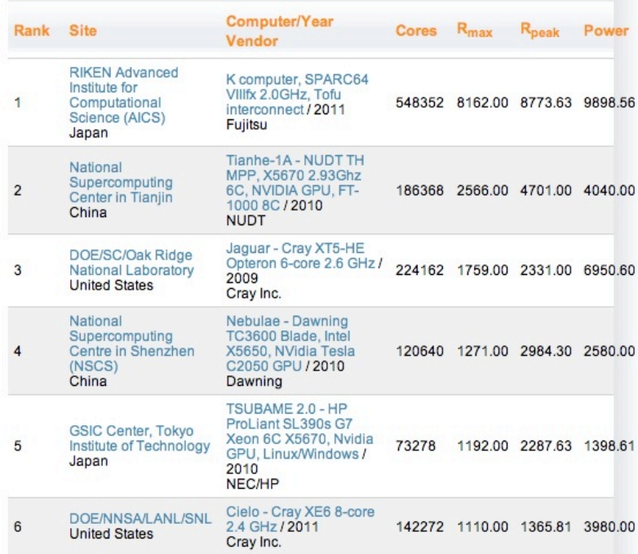
9.1 GPU简介
‣ Graphics market is
hungry for better and
faster rendering
‣ Development is pushed
by this HUGE industry
- High quality product
- Cheap!
‣ Proven to be a real
alternative for scientific
applications
Top 500 list. June 2011

Slide 8
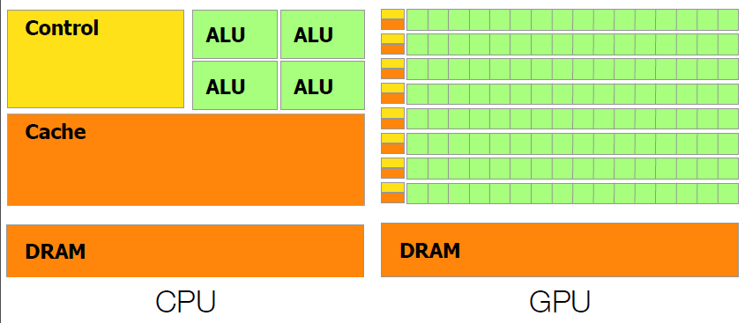
9.1 GPU简介
‣ CPU vs GPU
GPU devotes more transistors to data processing

Slide 9
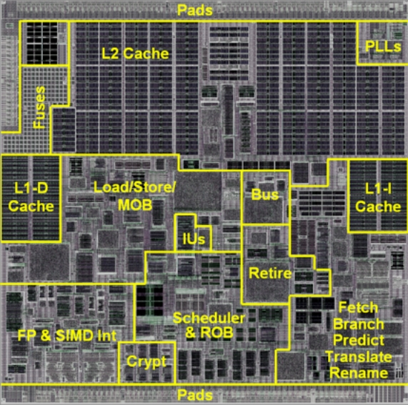
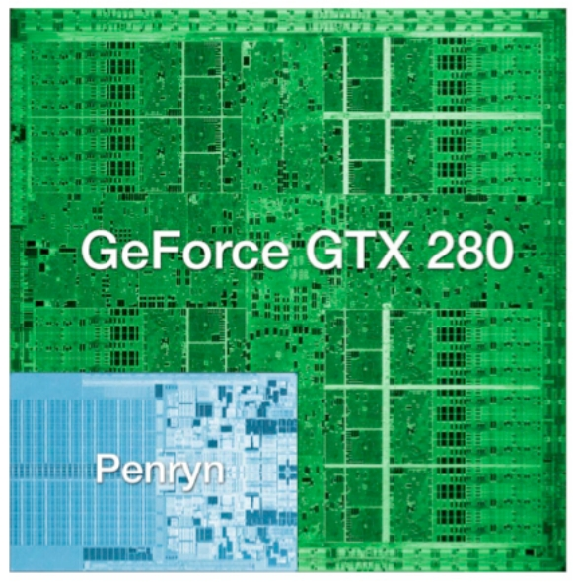
9.1 GPU简介
GPU chip

Slide 10
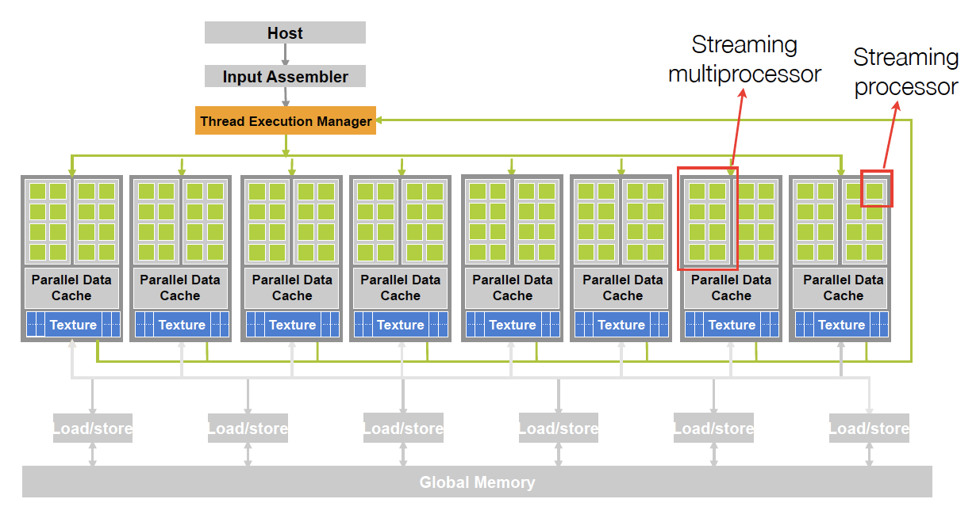
9.1 GPU简介

Slide 11
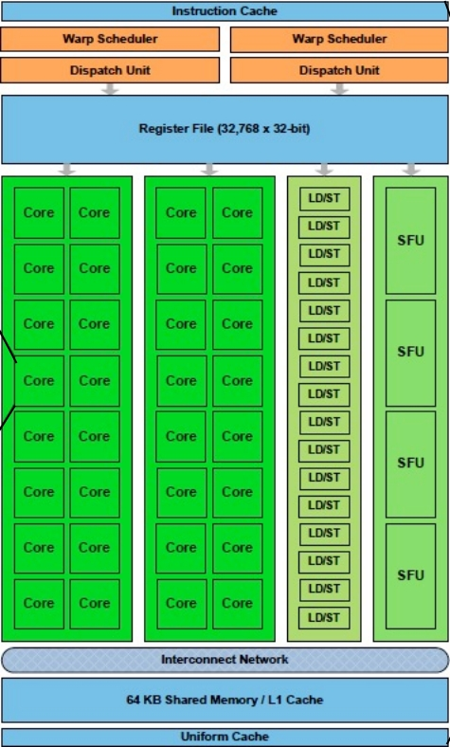
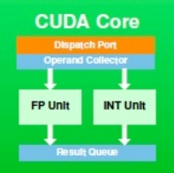
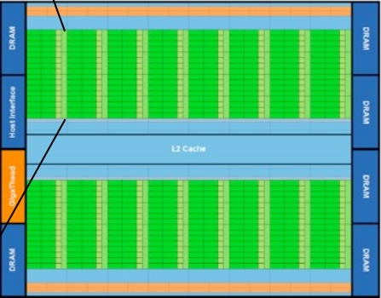
9.1 GPU简介
3 billion transistors
512 CUDA cores (32
in 16 SMs)
64kB of on chip RAM
High bandwidth
SP
SM

Slide 12
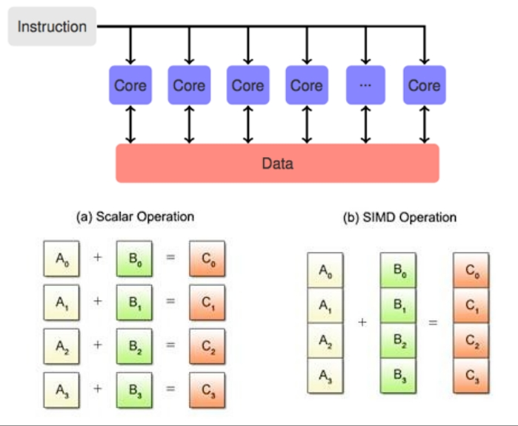
9.1 GPU简介
The GPU core is the stream processor
‣ Stream processors are grouped in Stream Multiprocessors
- SM is basically a SIMD processor (Single Instruction Multiple Data)

Slide 13
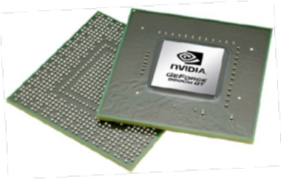
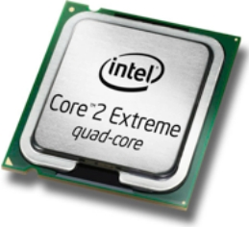
9.1 GPU简介
Core ideas
- GPUs consist of many “simple” cores
‣ Designed for many simpler tasks: high throughput
‣ Fewer control units: latency
Maximize throughput
of all threads
Minimize latency
of a thread

Slide 14


9.1 GPU简介
‣ Latency? Throughput?
- Latency: time to complete a task
- Throughput: number of tasks in a fixed time
‣ Decisions!?!
- Depends on the problem
Execution time
Bandwidth
“If you were plowing a ﬁeld,
which would you rather use: two
strong oxen or 1024 chicken?”
Seymour Cray
20

Slide 15
9.1 GPU简介
‣ 1024 chicken? We better have a strategy!
- Rethink our algorithms to be more parallel friendly
- Massively parallel:
‣ Data parallelism
‣ Load balancing
‣ Regular computations
‣ Data access
‣ Avoid conflicts
‣ and so on...

Slide 16


9.2 CUDA编程模型
Computer Unified Device Architecture (CUDA)
Parallel computer architecture developed by NVIDIA
‣ General purpose programming model
‣ Specially designed for General Purpose GPU computing:
- Offers a compute designed API
- Explicit GPU memory managing

Slide 17
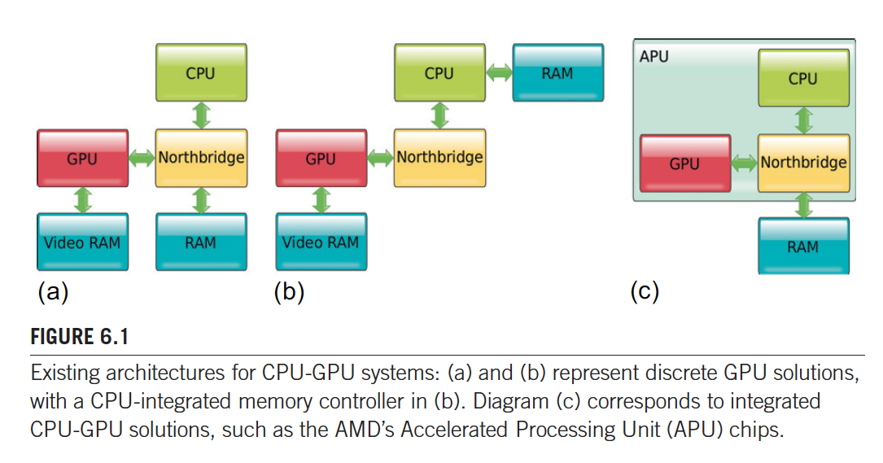
9.2 CUDA编程模型

Slide 18
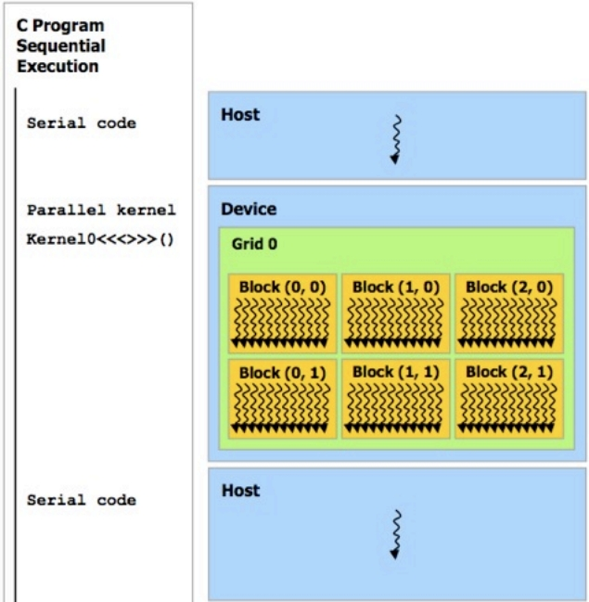
9.2 CUDA编程模型
CUDA - Main features
‣ C/C++ with extensions
‣ Heterogeneous
programming model:
- Operates in CPU (host)
and GPU (device)
Host
Device
CPU
GPU

Slide 19
CUDA - Threads
‣ In CUDA, a kernel is executed by many threads
- A thread is a sequence of executions
- Multi-thread: many threads will be running at the same time
__global__ void vec_add (float *A, float *B, float *C, int N){
int i = threadIdx.x + blockDim.x*blockIdx.x;
if (i>=N) {return;}
C[i] = A[i] + B[i];
}
void vec_add (float *A, float *B, float *C, int N){
for (int i=0; i<N; i++)
C[i] = A[i] + B[i];
}
25

Slide 20
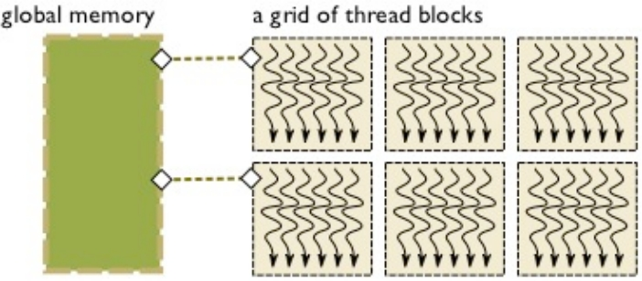
CUDA - Threads
‣ Threads are grouped into thread blocks
- Programming abstraction
- All threads within a thread block run in the same SM
- Threads of the same block can communicate
‣ Thread blocks conform a grid
26

Slide 21
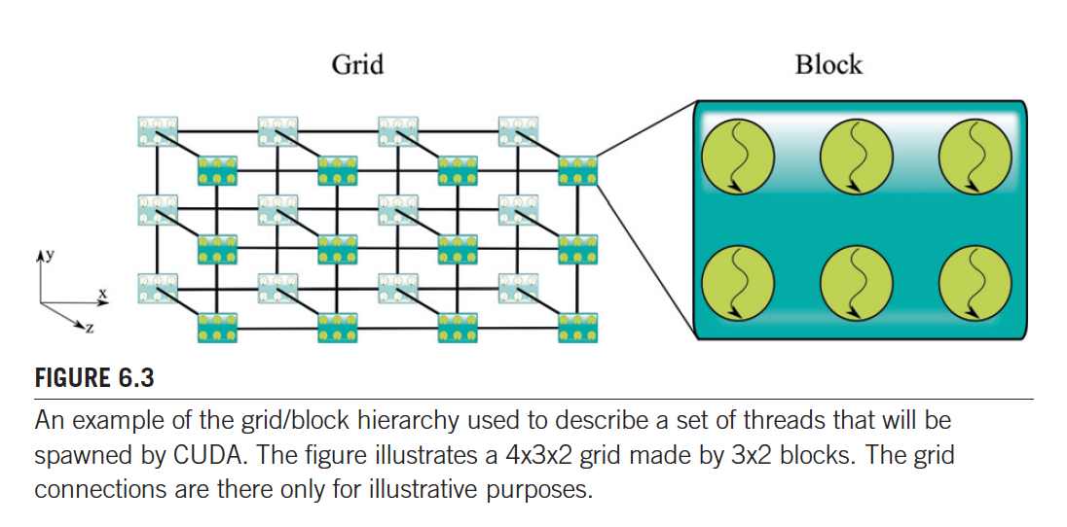
CUDA - Threads
26

Slide 22
CUDA - Threads
‣ CUDA virtualizes the physical hardware
- Thread is a virtualized scalar processor
- Thread blocks is a virtualized multiprocessors
‣ Thread blocks need to be independent
- They run to completion
- No idea in which order they run
27

Slide 23
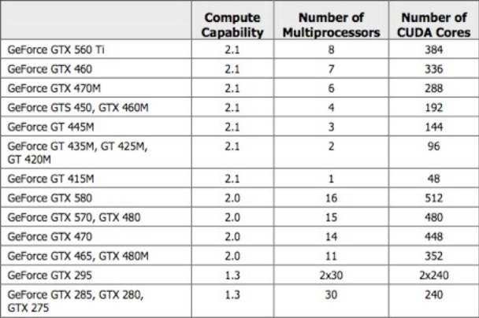
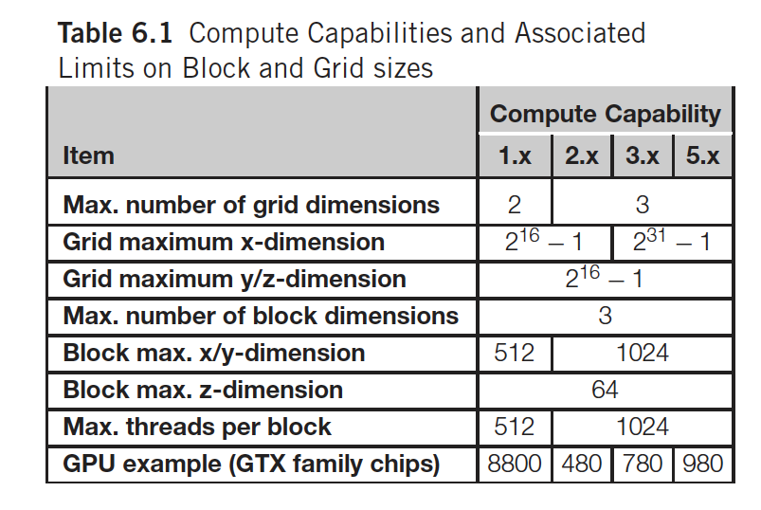
CUDA enabled GPUs
‣ What is the difference between GPUs
- CUDA enabled GPUs
- GPUs classified according to compute capability
CUDA Programming Guide Appendix A
23

Slide 24
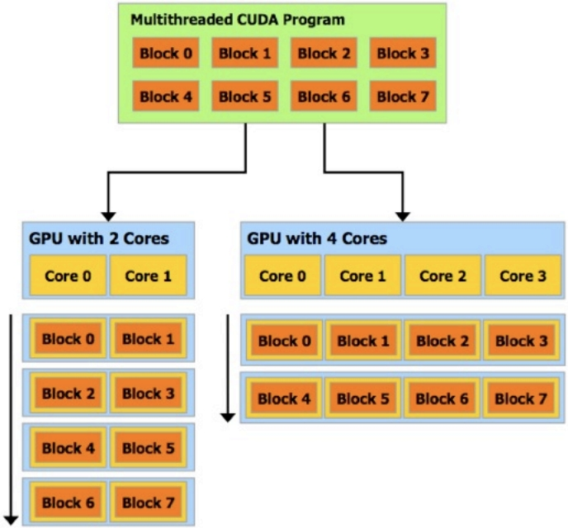
CUDA - Threads
‣ Provides automatic scalability
across GPUs
- Thread hierarchy
- Shared memories
- Barrier synchronization
28

Slide 25
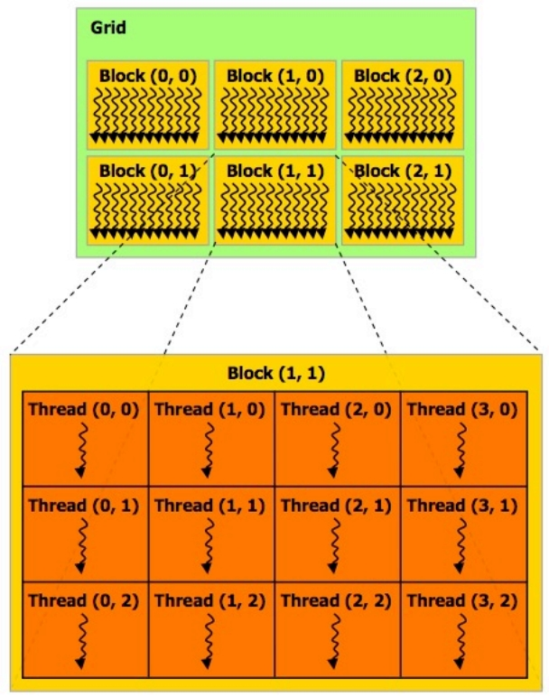
CUDA - Threads
‣ Threads have a unique
combination of block ID
and thread ID
- We can operate in
different parts of the
data
- SIMT: Single Instruction
Multiple Threads
- Threads: 1D, 2D or 3D
- Blocks: 1D or 2D
29

Slide 26
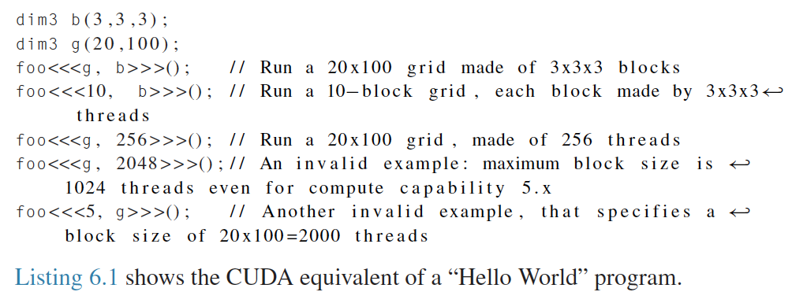
CUDA - Threads
27

Slide 27
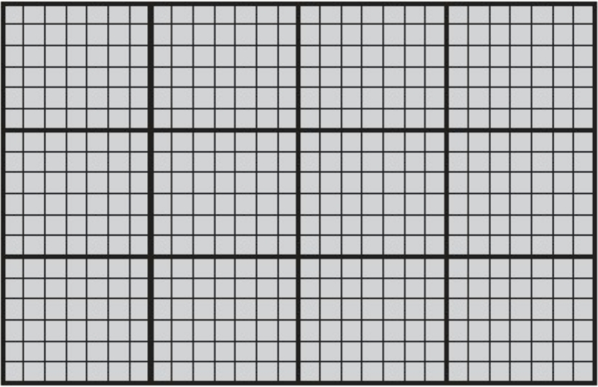
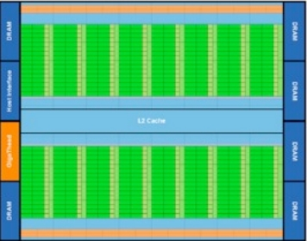
CUDA - Programming model
‣ Connecting the hardware and the software
Hardware
Software representation
6

Slide 28
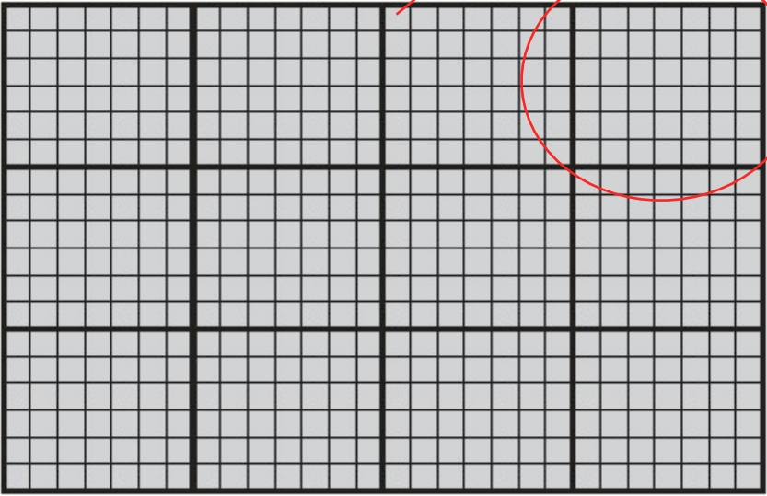
CUDA - Programming model
‣ Connecting the hardware and the software
Thread
Thread block
Hardware
Software representation
6

Slide 29
CUDA - Programming model
‣ Connecting the hardware and the software
Hardware
Software representation
6

Slide 30
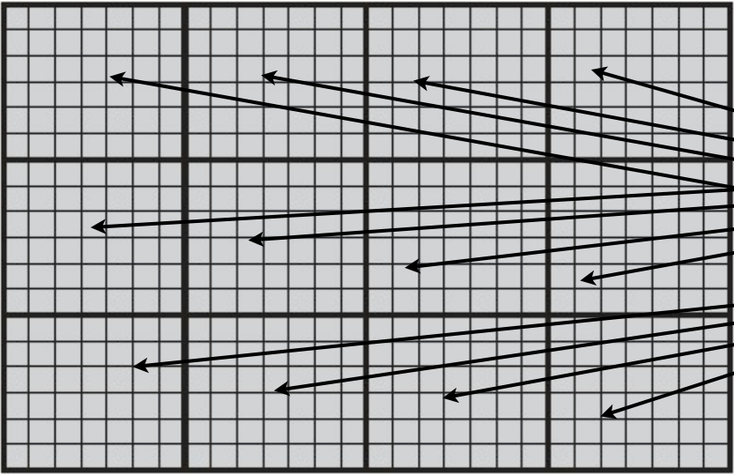
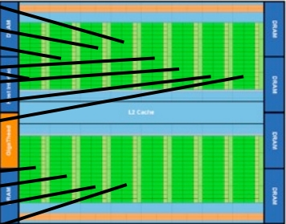
CUDA - Programming model
‣ Connecting the hardware and the software
Hardware
Software representation
6

Slide 31
How a Streaming Multiprocessor (SM) works
‣ Hardware schedules thread blocks onto available SMs
- No guarantee of order of execution
- If a SM has more resources the hardware will schedule more blocks
Block 100
Block 15
Block 7
Block 1
SM
8

Slide 32
How a Streaming Multiprocessor (SM) works
‣ Hardware schedules thread blocks onto available SMs
- No guarantee of order of execution
- If a SM has more resources the hardware will schedule more blocks
Block 100
Block 15
Block 7
SM
Block1
8

Slide 33
How a Streaming Multiprocessor (SM) works
‣ Hardware schedules thread blocks onto available SMs
- No guarantee of order of execution
- If a SM has more resources the hardware will schedule more blocks
Block 100
Block 15
Block7
Block1
SM
8

Slide 34
How a Streaming Multiprocessor (SM) works
‣ Hardware schedules thread blocks onto available SMs
- No guarantee of order of execution
- If a SM has more resources the hardware will schedule more blocks
Block 100
Block15
Block7
Block1
SM
8

Slide 35
How a Streaming Multiprocessor (SM) works
‣ Hardware schedules thread blocks onto available SMs
- No guarantee of order of execution
- If a SM has more resources the hardware will schedule more blocks
Block 100
Block15
Block7
SM
8

Slide 36
How a Streaming Multiprocessor (SM) works
‣ Hardware schedules thread blocks onto available SMs
- No guarantee of order of execution
- If a SM has more resources the hardware will schedule more blocks
Block15
Block7
Block100
SM
8

Slide 37
Warps
‣ Inside the SM, threads are launched in groups of 32 called warps
- Warps share the control part (warp scheduler)
- At any time, only one warp is executed per SM
- Threads in a warp will be executing the same instruction
- Half warps for compute capability 1.X
- Fermi:
‣ Maximum number of active threads 1024*8*32 = 262144
9

Slide 38
Warps
‣ Inside the SM, threads are launched in groups of 32 called warps
- Warps share the control part (warp scheduler)
- At any time, only one warp is executed per SM
- Threads in a warp will be executing the same instruction
- Half warps for compute capability 1.X
Max threads
per block
- Fermi:
‣ Maximum number of active threads 1024*8*32 = 262144
9

Slide 39
Warps
‣ Inside the SM, threads are launched in groups of 32 called warps
- Warps share the control part (warp scheduler)
- At any time, only one warp is executed per SM
- Threads in a warp will be executing the same instruction
- Half warps for compute capability 1.X
Max blocks
per SM
Max threads
per block
- Fermi:
‣ Maximum number of active threads 1024*8*32 = 262144
9

Slide 40
Warps
‣ Inside the SM, threads are launched in groups of 32 called warps
- Warps share the control part (warp scheduler)
- At any time, only one warp is executed per SM
- Threads in a warp will be executing the same instruction
- Half warps for compute capability 1.X
Max blocks
per SM
Max threads
per block
SMs
- Fermi:
‣ Maximum number of active threads 1024*8*32 = 262144
9

Slide 41
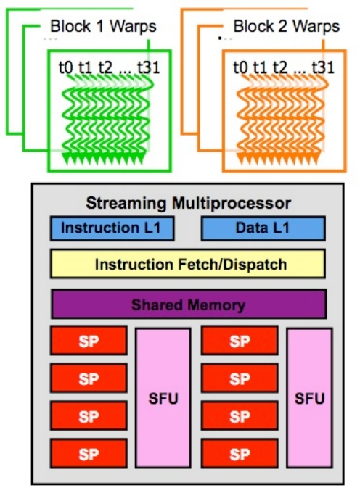
Warp designation
‣ Hardware separates threads of a
block into warps
- All threads in a warp correspond
to the same thread block
- Threads are placed in a warp
sequentially
- Threads are scheduled in warps
Block N, Warp 1
Block N, Warp 2
Block N, Warp 3
BlockN
16x8 TB
Block N, Warp 4
© David Kirk/NVIDIA and Wen-mei W. Hwu, 2007-2009 !
ECE498AL, University of Illinois, Urbana-Champaign ! 10

Slide 42
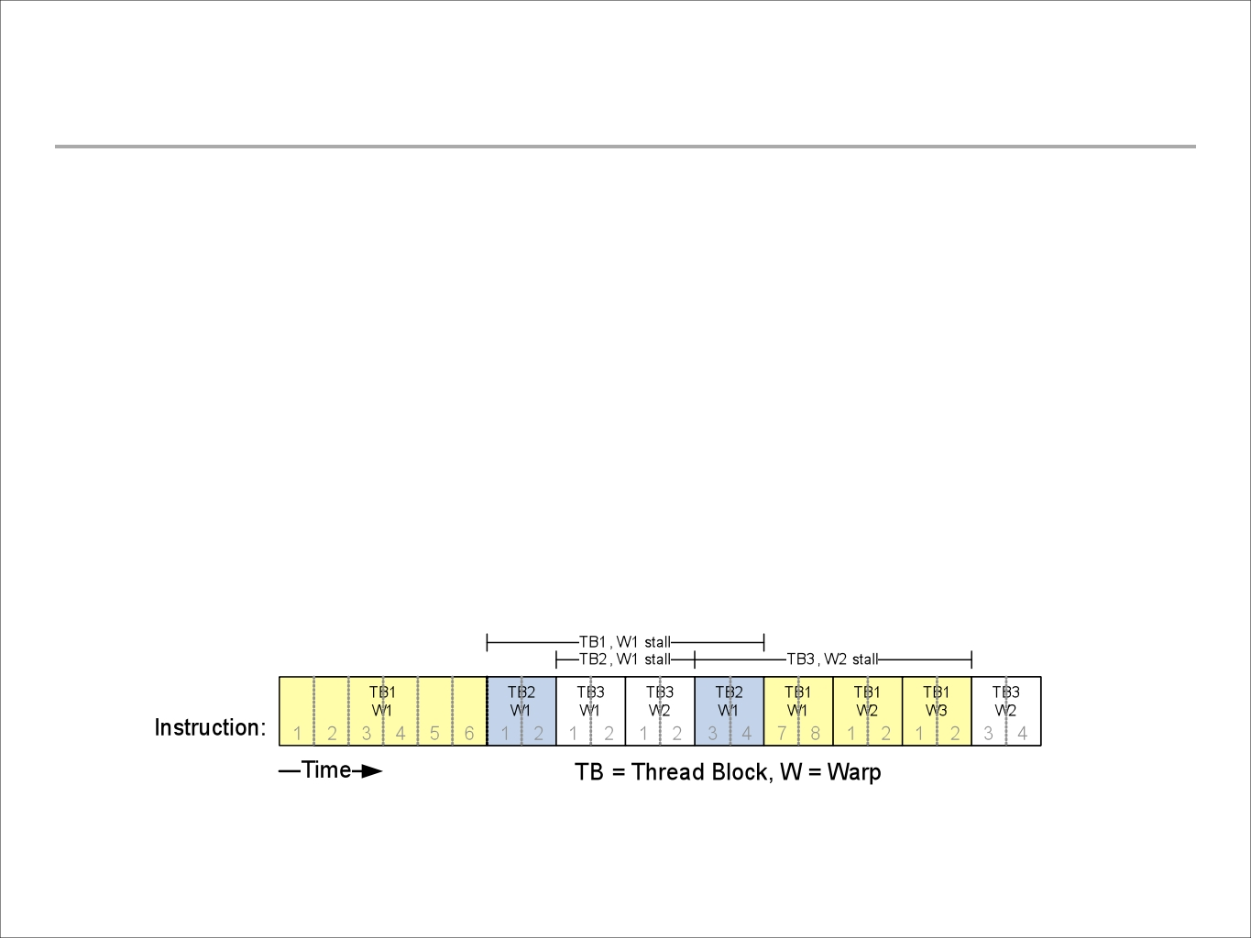
Warp scheduling
‣ The SM implements a zero-overhead warp scheduling
- Warps whose next instruction has its operands ready for
consumption are eligible for execution
- Eligible warps are selected for execution on a prioritized scheduling
policy
- All threads in a warp execute the same instruction
© David Kirk/NVIDIA and Wen-mei W. Hwu, 2007-2009 !
ECE498AL, University of Illinois, Urbana-Champaign !
11

Slide 43
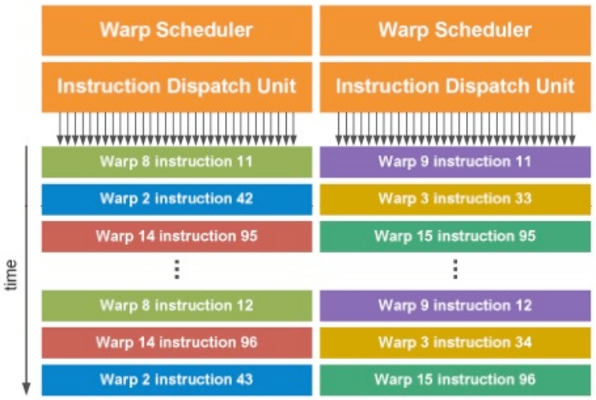
Warp scheduling
‣ Fermi
- Double warp scheduler
- Each SM has two warp
schedulers and two
instruction units
12

Slide 44
CUDA Programming Basics

Slide 45
C Extension
• New syntax and built-in variables
• New restrictions
– No recursion in device code
– No function pointers in device code
• API/Libraries
–
–
–
–
–
CUDA Runtime (Host and Device)
Device Memory Handling (cudaMalloc,...)
Built-in Math Functions (sin, sqrt, mod, ...)
Atomic operations (for concurrency)
Data types (2D textures, dim2, dim3, ...)

Slide 46
New Syntax
<<< ... >>>
__host__, __global__, __device__
__constant__, __shared__, __device__
__syncthreads()
•
•
•
•

Slide 47
Built-in Variables
• dim3 gridDim;
– Dimensions of the grid in blocks(gridDim.z unused)
• dim3 blockDim;
– Dimensions of the block in threads
• dim3 blockIdx;
– Block index within the grid
• dim3 threadIdx;
– Thread index within the block
dim3 (Based on uint3)
struct dim3{int x,y,z;}
Used to specify dimensions
Default value (1,1,1)

Slide 48
Function Qualifiers
CPU启动，GPU执行；需要返回void
• __global__ : called from the host (CPU) code, and run
on GPU
– cannot be called from device (GPU) code
– must return void
• __device__ : called from other GPU functions, and run
on GPU
– cannot be called from host (CPU) code
• __host__ : called from host , and run on CPU,
• __host__ and __device__:
– Sample use: overloading operators
– Compiler will generate both CPU and GPU code

Slide 49
Variable Qualifiers (GPU code)
• __device__: stored in global memory (not cached, high
latency)
– accessible by all threads
– lifetime: application
• __constant__: stored in global memory (cached)
– read-only for threads, written by host
– Lifetime: application
• __shared__: stored in shared memory (like registers)
– accessible by all threads in the same threadblock
– lifetime: block lifetime
• Unqualified variables: stored in local memory
– scalars and built-in vector types are stored in registers
– arrays are stored in device memory

Slide 50
EXECUTING CODES ON GPU

Slide 51
__global__
__global__ void minimal( int* d_a)
{
*d_a = 13;
}
__global__ void assign( int* d_a, int value)
{
int idx = blockDim.x * blockIdx.x + threadIdx.x;
d_a[idx] = value;
}
找出全局要处理的点，块维度*块索引+块内索引

Slide 52
Launching kernels
• Modified C function call syntax:
kernel<<<dim3 grid, dim3 block >>>(…)
– Execution Configuration (“<<< >>>”):
– grid dimensions: x and y
– thread-block dimensions : x, y, and z

Slide 53
EX: VecAdd
• Add two vectors, A and B, of dimension N, and
put result to vector C
// Kernel definition
__global__ void VecAdd( float * A, float * B, float * C)
{
int i = threadIdx .x;
C[i] = A[i] + B[i];
取一块
}
int main()
{...
// Kernel invocation
VecAdd <<< 1, N >>> (A, B, C);
}

Slide 54
EX: MatAdd
• Add two matrices, A and B, of dimension N,
and put result to matrix C
// Kernel definition
__global__ void MatAdd( float A[N][N], float B[N][N], float C[N][N]){
int i = threadIdx .x;
int j = threadIdx .y;
C[i][j] = A[i][j] + B[i][j];
}
int main(){
...
// Kernel invocation
dim3 dimBlock(N, N);
MatAdd <<< 1, dimBlock >>> (A, B, C);
}

Slide 55
Executing Code on the GPU
• Kernels are C functions with some restrictions
– Can only access GPU memory
– Must have void return type
– No variable number of arguments (“ varargs ”)
– Not recursive
– No static variables
• Function arguments automatically copied
from CPU to GPU memory

Slide 56
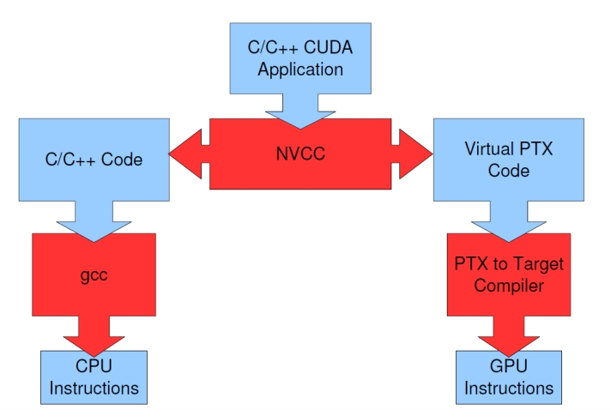
Compiling a CUDA Program

Slide 57
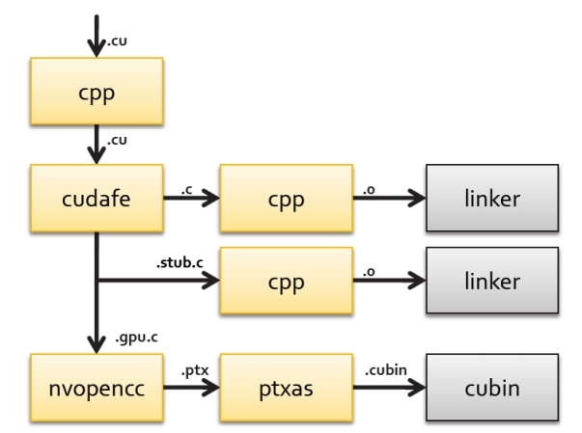
Compiled files

Slide 58
CUDA - Program execution
Allocate and initialize data on CPU
Allocate data on GPU
Transfer data from CPU to GPU
Run kernel
Transfer data from
GPU to CPU
31

Slide 59
CUDA - Vector add example
__global__ void vec_add (float *A, float *B, float *C, int N)
{
// Using 1D threadID and block ID
int i = threadIdx.x + blockDim.x*blockIdx.x;
if (i>=N) {return;}
C[i] = A[i] + B[i];
}
int main()
{
....
// Launch kernel with N/256 blocks of 256 threads
int blocks = int(N‐0.5)/256 + 1;
vec_add<<<blocks, 256>>> (A_d, B_d, C_d, N);
}
32

Slide 60
CUDA - Vector add example
__global__ void vec_add (float *A, float *B, float *C, int N)
{
// Using 1D threadID and block ID
if (i>=N) {return;}
C[i] = A[i] + B[i];
}
int main()
{
....
// Launch kernel with N/256 blocks of 256 threads
int blocks = int(N‐0.5)/256 + 1;
vec_add<<<blocks, 256>>> (A_d, B_d, C_d, N);
}
indexing
int i = threadIdx.x + blockDim.x*blockIdx.x; Thread
32

Slide 61
CUDA - Vector add example
__global__ void vec_add (float *A, float *B, float *C, int N)
{
// Using 1D threadID and block ID
int i = threadIdx.x + blockDim.x*blockIdx.x;
if (i>=N) {return;}
C[i] = A[i] + B[i];
}
int main()
{
Perform operation
....
// Launch kernel with N/256 blocks of 256 threads
int blocks = int(N‐0.5)/256 + 1;
vec_add<<<blocks, 256>>> (A_d, B_d, C_d, N);
}
32

Slide 62
CUDA - Vector add example
int N = 200;
// Allocate and initialize host CPU
float *A_h = new float[N];
float *B_h = new float[N];
float *C_h = new float[N];
for(int i=0; i<N; i++)
{ A_h[i] = 1.3f;
B_h[i] = 2.0f;
}
// Allocate memory on the GPU
float *A_d, *B_d, *C_d;
cudaMalloc( (void**) &A_d, N*sizeof(float));
cudaMalloc( (void**) &B_d, N*sizeof(float));
cudaMalloc( (void**) &C_d, N*sizeof(float));
// Copy host memory to device
cudaMemcpy(A_d, A_h, N*sizeof(float), cudaMemcpyHostToDevice);
cudaMemcpy(B_d, B_h, N*sizeof(float), cudaMemcpyHostToDevice);
33

Slide 63
CUDA - Vector add example
int N = 200;
// Allocate and initialize host CPU
float *A_h = new float[N];
float *B_h = new float[N];
float *C_h = new float[N];
CPU allocation
for(int i=0; i<N; i++)
{ A_h[i] = 1.3f;
B_h[i] = 2.0f;
}
// Allocate memory on the GPU
float *A_d, *B_d, *C_d;
cudaMalloc( (void**) &A_d, N*sizeof(float));
cudaMalloc( (void**) &B_d, N*sizeof(float));
cudaMalloc( (void**) &C_d, N*sizeof(float));
// Copy host memory to device
cudaMemcpy(A_d, A_h, N*sizeof(float), cudaMemcpyHostToDevice);
cudaMemcpy(B_d, B_h, N*sizeof(float), cudaMemcpyHostToDevice);
33

Slide 64
CUDA - Vector add example
int N = 200;
// Allocate and initialize host CPU
float *A_h = new float[N];
float *B_h = new float[N];
float *C_h = new float[N];
for(int i=0; i<N; i++)
{ A_h[i] = 1.3f;
B_h[i] = 2.0f;
}
// Allocate memory on the GPU
float *A_d, *B_d, *C_d;
cudaMalloc( (void**) &A_d, N*sizeof(float));
GPU allocation
cudaMalloc( (void**) &B_d, N*sizeof(float));
cudaMalloc( (void**) &C_d, N*sizeof(float));
// Copy host memory to device
cudaMemcpy(A_d, A_h, N*sizeof(float), cudaMemcpyHostToDevice);
cudaMemcpy(B_d, B_h, N*sizeof(float), cudaMemcpyHostToDevice);
33

Slide 65
CUDA - Vector add example
int N = 200;
// Allocate and initialize host CPU
float *A_h = new float[N];
float *B_h = new float[N];
float *C_h = new float[N];
for(int i=0; i<N; i++)
{ A_h[i] = 1.3f;
B_h[i] = 2.0f;
}
// Allocate memory on the GPU
float *A_d, *B_d, *C_d;
cudaMalloc( (void**) &A_d, N*sizeof(float));
cudaMalloc( (void**) &B_d, N*sizeof(float));
cudaMalloc( (void**) &C_d, N*sizeof(float));
Copy to device
// Copy host memory to device
cudaMemcpy(A_d, A_h, N*sizeof(float), cudaMemcpyHostToDevice);
cudaMemcpy(B_d, B_h, N*sizeof(float), cudaMemcpyHostToDevice);
33

Slide 66
CUDA - Vector add example
// Copy host memory to device
cudaMemcpy(A_d, A_h, N*sizeof(float), cudaMemcpyHostToDevice);
cudaMemcpy(B_d, B_h, N*sizeof(float), cudaMemcpyHostToDevice);
// Run grid of N/256 blocks of 256 threads each
int blocks = int(N‐0.5)/256 + 1;
vec_add<<<blocks, 256>>> (A_d, B_d, C_d, N);
// Copy back from device to host
cudaMemcpy(C_h, C_d, N*sizeof(float), cudaMemcpyDeviceToHost);
// Free device
cudaFree(A_d);
cudaFree(B_d);
cudaFree(C_d);
34

Slide 67
CUDA - Vector add example
Copy to device
// Copy host memory to device
cudaMemcpy(A_d, A_h, N*sizeof(float), cudaMemcpyHostToDevice);
cudaMemcpy(B_d, B_h, N*sizeof(float), cudaMemcpyHostToDevice);
// Run grid of N/256 blocks of 256 threads each
int blocks = int(N‐0.5)/256 + 1;
vec_add<<<blocks, 256>>> (A_d, B_d, C_d, N);
// Copy back from device to host
cudaMemcpy(C_h, C_d, N*sizeof(float), cudaMemcpyDeviceToHost);
// Free device
cudaFree(A_d);
cudaFree(B_d);
cudaFree(C_d);
34

Slide 68
CUDA - Vector add example
// Copy host memory to device
cudaMemcpy(A_d, A_h, N*sizeof(float), cudaMemcpyHostToDevice);
cudaMemcpy(B_d, B_h, N*sizeof(float), cudaMemcpyHostToDevice);
// Run grid of N/256 blocks of 256 threads each
int blocks = int(N‐0.5)/256 + 1;
vec_add<<<blocks, 256>>> (A_d, B_d, C_d, N);
// Copy back from device to host
Launch kernel
cudaMemcpy(C_h, C_d, N*sizeof(float), cudaMemcpyDeviceToHost);
// Free device
cudaFree(A_d);
cudaFree(B_d);
cudaFree(C_d);
34

Slide 69
CUDA - Vector add example
// Copy host memory to device
cudaMemcpy(A_d, A_h, N*sizeof(float), cudaMemcpyHostToDevice);
cudaMemcpy(B_d, B_h, N*sizeof(float), cudaMemcpyHostToDevice);
// Run grid of N/256 blocks of 256 threads each
int blocks = int(N‐0.5)/256 + 1;
vec_add<<<blocks, 256>>> (A_d, B_d, C_d, N);
// Copy back from device to host
cudaMemcpy(C_h, C_d, N*sizeof(float), cudaMemcpyDeviceToHost);
Copy back to host
// Free device
cudaFree(A_d);
cudaFree(B_d);
cudaFree(C_d);
34

Slide 70
CUDA - Vector add example
// Copy host memory to device
cudaMemcpy(A_d, A_h, N*sizeof(float), cudaMemcpyHostToDevice);
cudaMemcpy(B_d, B_h, N*sizeof(float), cudaMemcpyHostToDevice);
// Run grid of N/256 blocks of 256 threads each
int blocks = int(N‐0.5)/256 + 1;
vec_add<<<blocks, 256>>> (A_d, B_d, C_d, N);
// Copy back from device to host
cudaMemcpy(C_h, C_d, N*sizeof(float), cudaMemcpyDeviceToHost);
// Free device
cudaFree(A_d);
cudaFree(B_d);
cudaFree(C_d);
Free device
34

Slide 71
CUDA - Vector add example
__global__ void vec_add (float *A, float *B, float *C, int N)
{
// Using 1D threadID and block ID
int i = threadIdx.x + blockDim.x*blockIdx.x;
if (i>=N) {return;}
C[i] = A[i] + B[i];
}
Thread 0
Fetch
A[0], B[0]
Operate
Write C[0]
Thread i
Fetch
A[i], B[i]
Operate
Write C[i]
Thread i+1
Fetch
A[i+1], B[i+1]
Operate
Write C[i+1]
Thread N-1
Fetch
A[N-1], B[N-1]
Operate
Write C[N-1]
...
...
35

Slide 72

CUDA - To keep in mind
‣ Keep executions simple
- Leave tough things to the CPU
‣ Performance:
- Load balance
- Data parallelism
- Avoid conflicts
- Keep the GPU busy!
‣ How fast can we go?
36

Slide 73
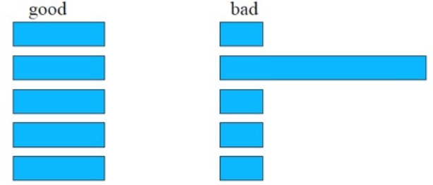

CUDA - To keep in mind
‣ Load balance
- All threads should do the same
amount of work
‣ Data Parallelism (Massive)
- Arrange your algorithm so is data
parallel friendly
- Look for regularity
‣ Avoid conflicts
- Data access conflicts will serialize
your applications or give you wrong
answers!
37

Slide 74
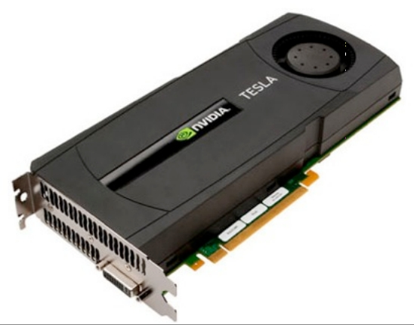
CUDA - To keep in mind
‣ Keep the GPU busy!
- High peak compute throughput compared to
bandwidth
- Fermi:
‣ 1TFLOP peak throughput, 144 GB/s peak off
chip memory access (36 Gfloats per second)
‣ 4*1TFLOP = 4000GB/s for peak throughput!
‣ 1000/36 ≈ 28 operations per fetched value
- Need to hide latency!
38

Slide 75
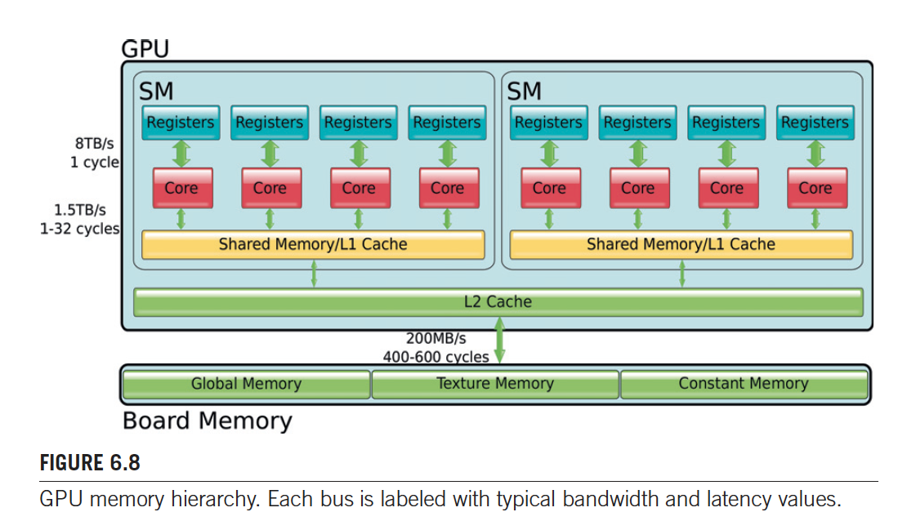
9.3 内存层次结构

Slide 76
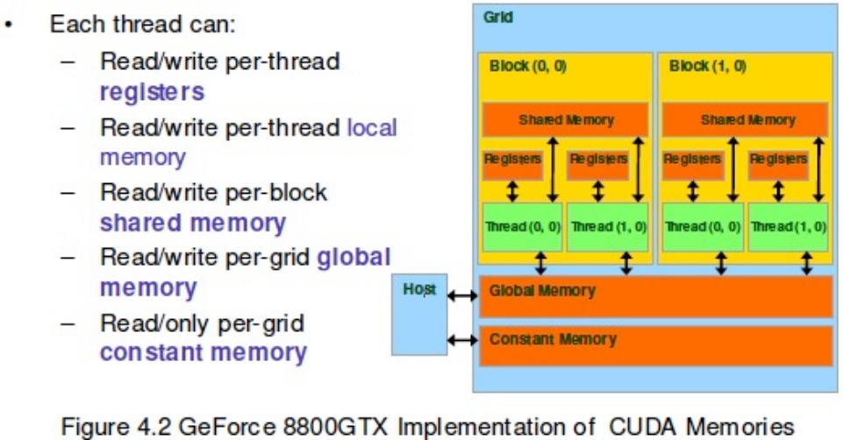
Memory hierarchy
‣ CUDA works in both the CPU and GPU
- One has to keep track of which memory is operating on
(host - device)
- Within the GPU there are also different memory spaces
13

Slide 77
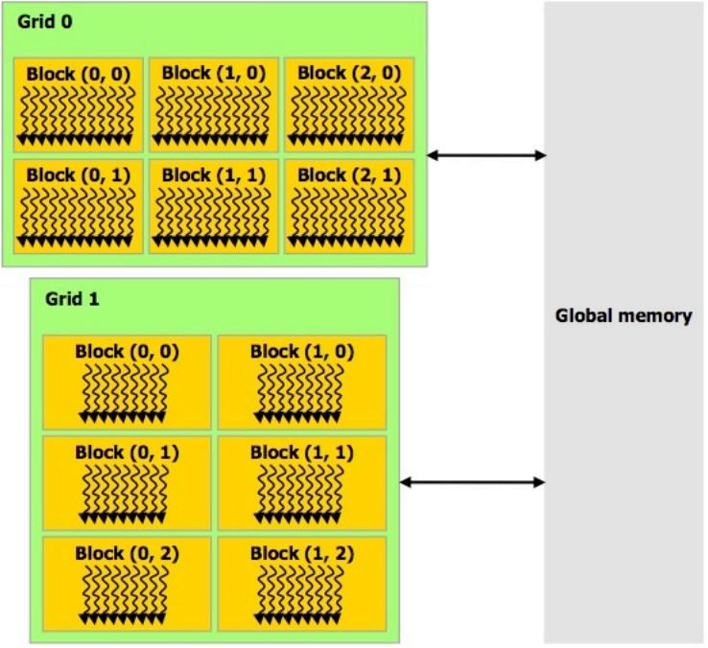
Memory hierarchy
‣ Global memory
- Main GPU memory
- Communicates with host
- Can be seen by all threads
- Order of GB
- Off chip, slow (~400
cycles)
__device__ float variable;
14

Slide 78

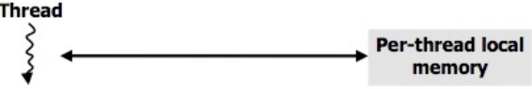
Memory hierarchy
‣ Shared memory
- Per SM
- Seen by threads of the same thread block
- Order of kB
- On chip, fast (~4 cycles)
‣ Registers
- Private to each thread
- On chip, fast
__shared__ float variable;
float variable;
15

Slide 79
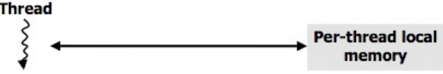
Memory hierarchy
‣ Local memory
- Private to each thread
- Off chip, slow
- Register overflows
‣ Constant memory
- Read only
- Off chip, but fast (cached)
- Seen by all threads
- 64kB with 8kB cache
float variable [10];
__constant__ float variable;
16

Slide 80
Memory hierarchy
‣ Texture memory
- Seen by all threads
- Read only
- Off chip, but fast (cached) if cache hit
- Cache optimized for 2D locality
- Binds to global
texture<type, dim> tex_var;
cudaChannelFormatDesc();
cudaBindTexture2D(...);
tex2D(tex_var, x_index, y_index);
17

Slide 81
Memory hierarchy
‣ Texture memory
- Seen by all threads
- Read only
- Off chip, but fast (cached) if cache hit
- Cache optimized for 2D locality
- Binds to global
Initialize
texture<type, dim> tex_var;
cudaChannelFormatDesc();
cudaBindTexture2D(...);
tex2D(tex_var, x_index, y_index);
17

Slide 82
Memory hierarchy
‣ Texture memory
- Seen by all threads
- Read only
- Off chip, but fast (cached) if cache hit
- Cache optimized for 2D locality
- Binds to global
Initialize
texture<type, dim> tex_var; Options
cudaChannelFormatDesc();
cudaBindTexture2D(...);
tex2D(tex_var, x_index, y_index);
17

Slide 83
Memory hierarchy
‣ Texture memory
- Seen by all threads
- Read only
- Off chip, but fast (cached) if cache hit
- Cache optimized for 2D locality
- Binds to global
Initialize
texture<type, dim> tex_var; Options
cudaChannelFormatDesc();
cudaBindTexture2D(...); Bind
tex2D(tex_var, x_index, y_index);
17

Slide 84
Memory hierarchy
‣ Texture memory
- Seen by all threads
- Read only
- Off chip, but fast (cached) if cache hit
- Cache optimized for 2D locality
- Binds to global
Initialize
texture<type, dim> tex_var; Options
cudaChannelFormatDesc();
cudaBindTexture2D(...); Bind
tex2D(tex_var, x_index, y_index);
Fetch
17

Slide 85
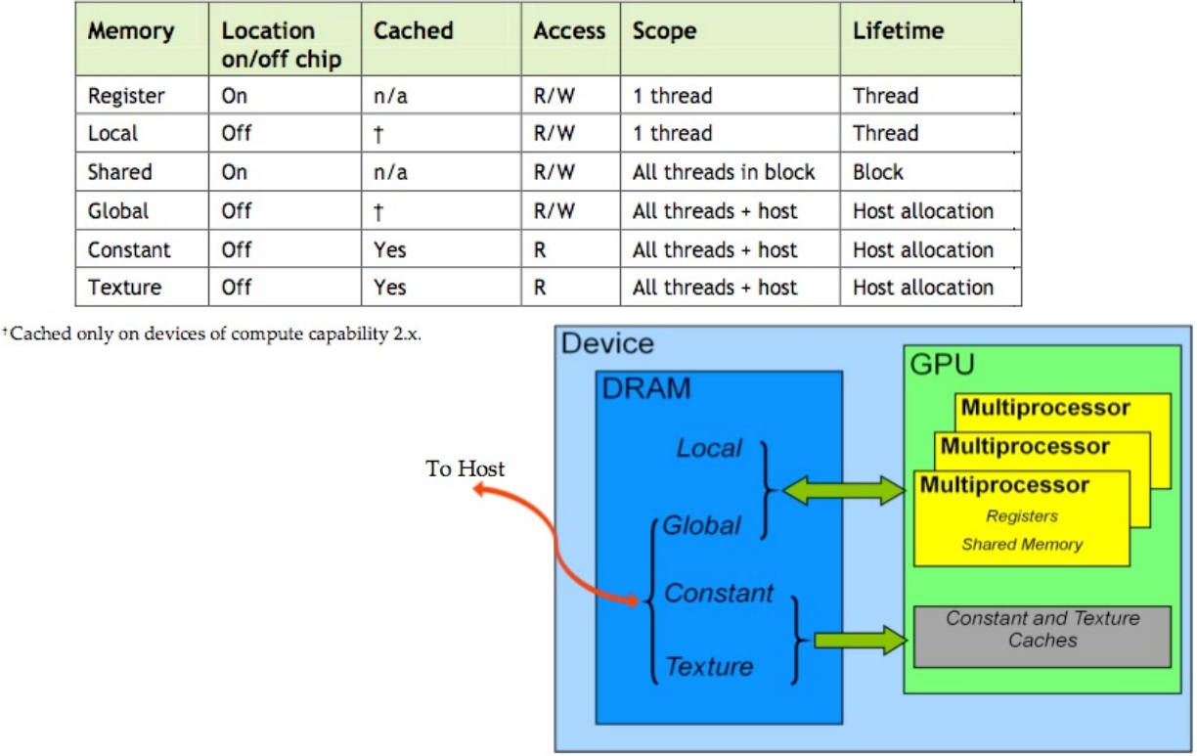
Memory hierarchy
18

Slide 86
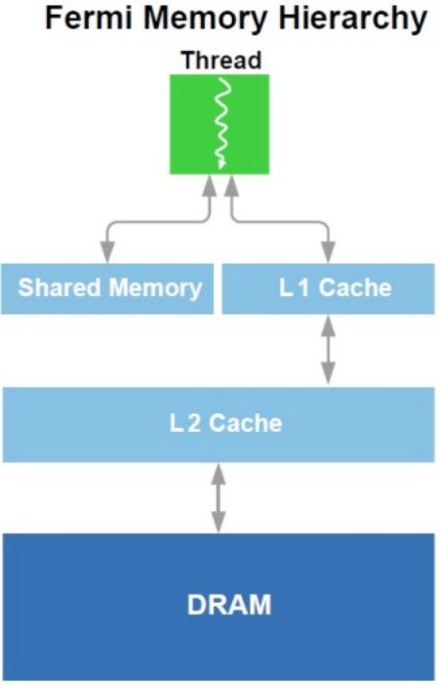
Memory hierarchy
‣ Case of Fermi
- Added an L1 cache to each SM
- Shared + cache = 64kB:
‣ Shared = 48kB, cache = 16kB
‣ Shared = 16kB, cache = 48kB
19

Slide 87
Memory hierarchy
‣ Use you memory strategically
- Read only: __constant__ (fast)
- Read/write and communicate within a block: __shared__ (fast and
communication)
- Read/write inside thread: registers (fast)
- Data locality: texture
20

Slide 88
Resource limits
‣ Number of thread blocks per SM at the same time is limited by
- Shared memory usage 线程申请了多少
- Registers 寄存器
- No more than 8 thread blocks per SM
- Number of threads
21

Slide 89
Resource limits - Examples
Number of blocks
How big should my blocks be? 8x8, 16x16 or 64x64?
‣ 8x8
Max threads
per block
8*8 = 64 threads per block, 1024/64 = 16 blocks. An SM can have up
to 8 blocks: only 512 threads will be active at the same time
‣ 16x16
16*16 = 256 threads per block, 1024/256 = 4 blocks. An SM can take
all blocks, then all 1024 threads will be active and achieve full capacity
unless other resource overrule
‣ 64x64
64*64 = 4096 threads per block: doesn’t fit in a SM
© David Kirk/NVIDIA and Wen-mei W. Hwu, 2007-2009 !
22
ECE498AL, University of Illinois, Urbana-Champaign !

Slide 90
Resource limits - Examples
Registers
We have a kernel that uses 10 registers. With 16x16 block, how many
blocks can run in G80 (max 8192 registers per SM, 768 threads per
SM)?
10*16*16 = 2560. SM can hold 8192/2560 = 3 blocks, meaning we will
use 3*16*16 = 768 threads, which is within limits.
If we add one more register, the number of registers grows to 11*16*16
= 2816. SM can hold 8192/2816 = 2 blocks, meaning we will use
2*16*15 = 512 threads. Now as less threads are running per SM is more
difficult to have enough warps to have the GPU always busy!
© David Kirk/NVIDIA and Wen-mei W. Hwu, 2007-2009 !
23
ECE498AL, University of Illinois, Urbana-Champaign !

Slide 91
Question?

